Slide 1



FRANS VAN DEN BOOMEN
PROGRAM ACTIVATOR
LEAN & GREEN OFF-ROAD
WWW.LEAN-GREENOFFROAD.NL

Slide 2
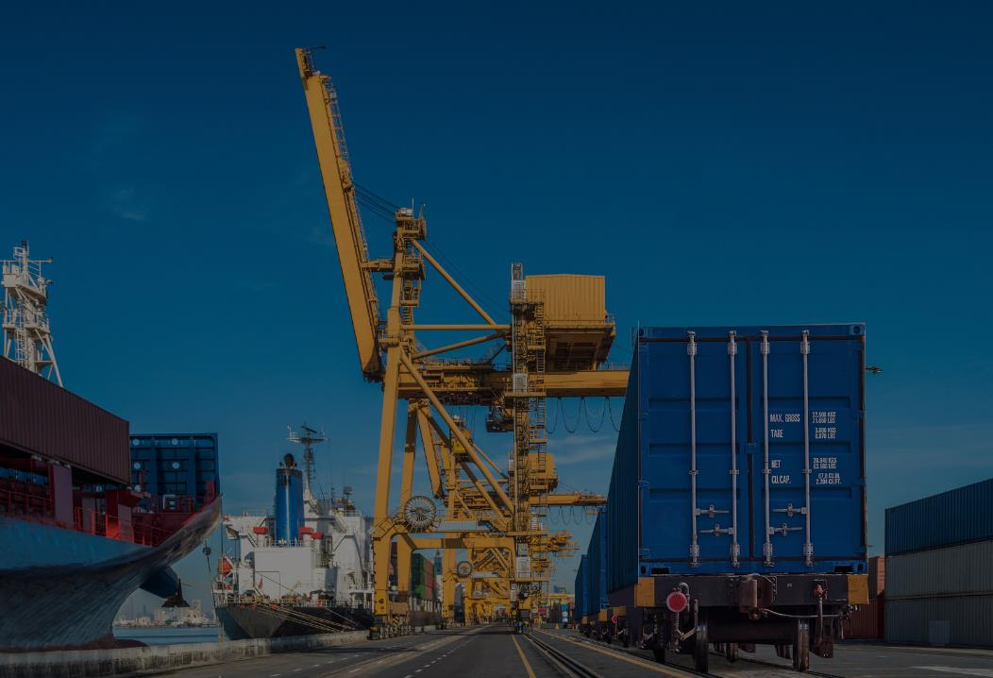
GO OFF-ROAD
WWW.LEAN-GREENOFFROAD.NL

Slide 3
JOINT CORRIDOR DEVELOPMENT
WWW.LEAN-GREENOFFROAD.NL

Slide 4



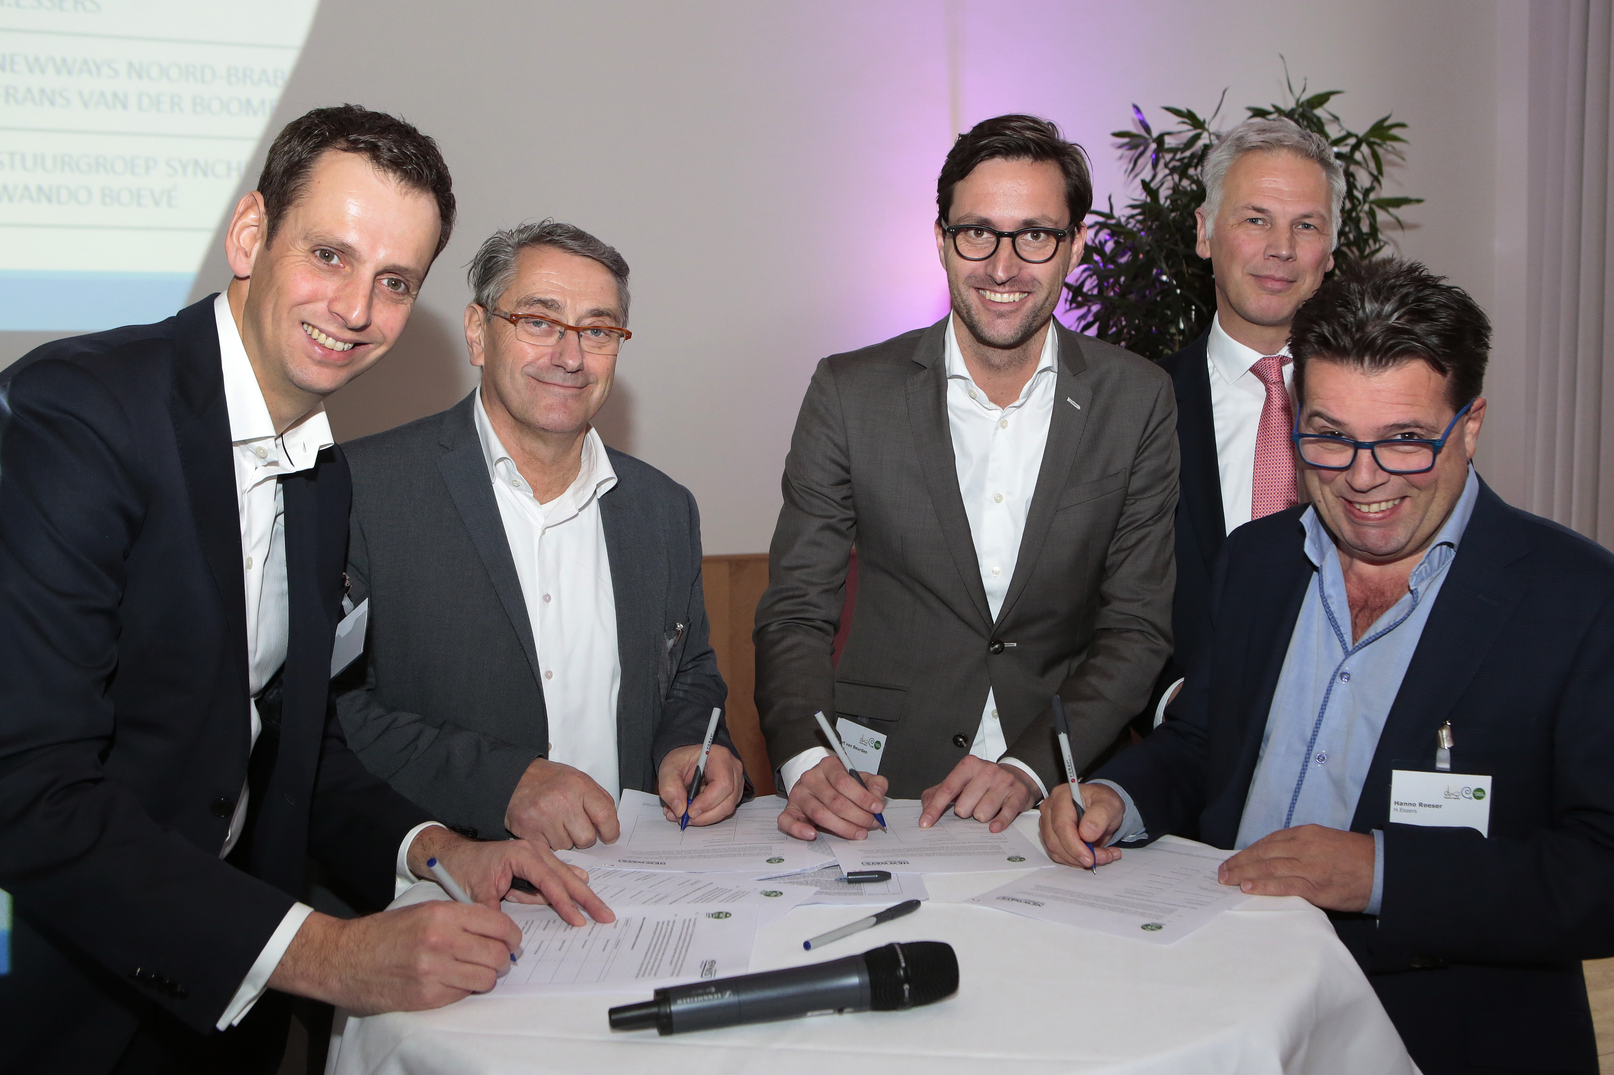
START-UP & SCALE-UP
WWW.LEAN-GREENOFFROAD.NL

Slide 5
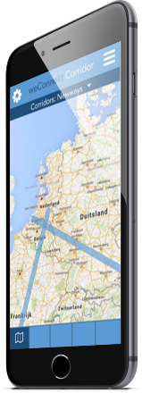
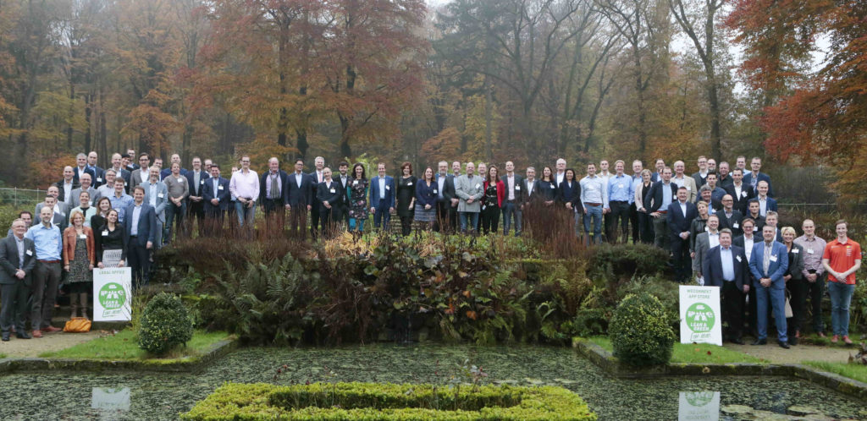
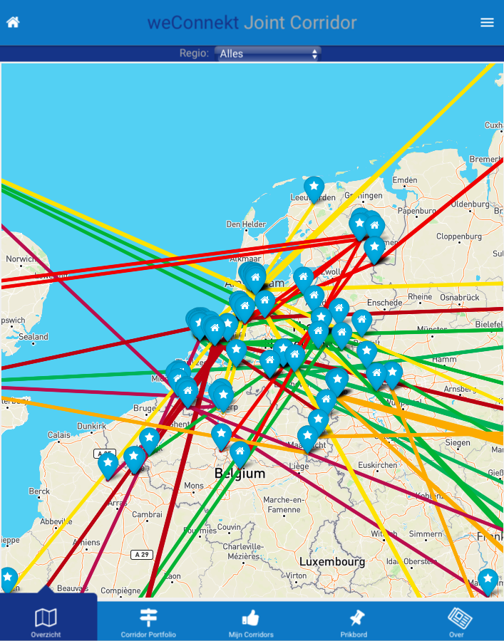
CONNECTIVITY
‘APP.WECONNEKT.NL’
WWW.LEAN-GREENOFFROAD.NL

Slide 6

SECURITY ‘LEGAL OFFICE’
DISCOVER ‘DISCLAIMER & RULES’
PROTOTYPE ‘INTENTION AGREEMENT’
RUN ‘COLLABORATION AGREEMENT’
WWW.LEAN-GREENOFFROAD.NL

Slide 7
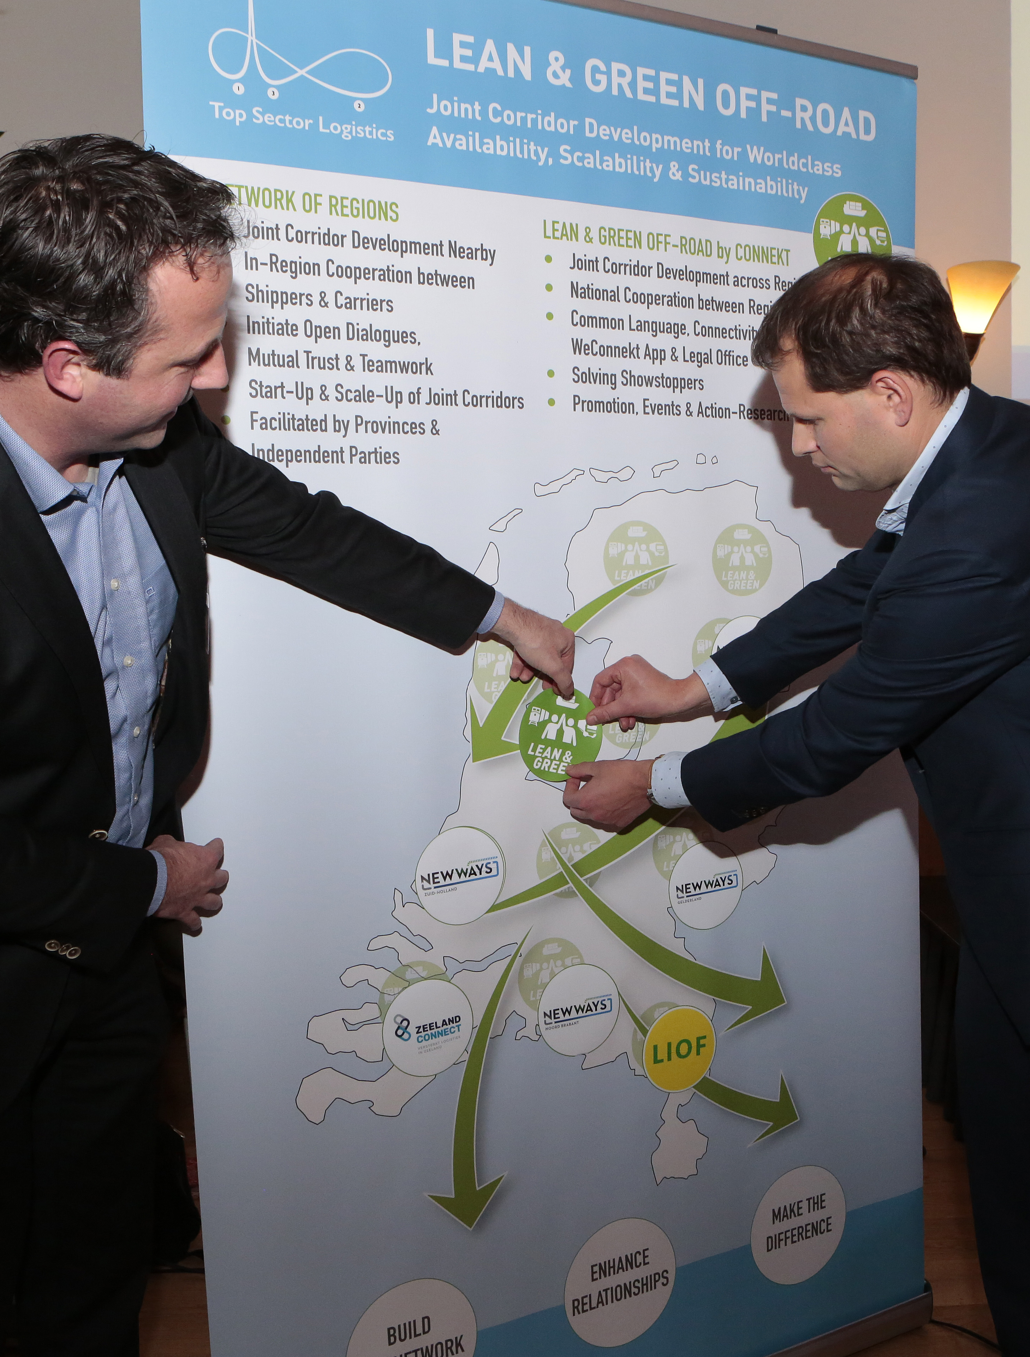
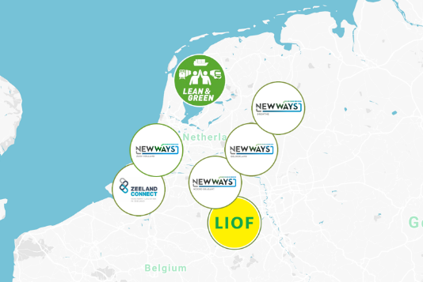



NETWORK OF REGIONS
WWW.LEAN-GREENOFFROAD.NL

Slide 8
JOINT CORRIDOR DEVELOPMENT
PERFECT AVAILABILITY
COLLABORATIVE SCALE
SUSTAINABILITY
MOBILITY
WWW.LEAN-GREENOFFROAD.NL

Slide 9
GO OFF-ROAD
WWW.LEAN-GREENOFFROAD.NL

Slide 10
WELCOME
JOIN US!
WWW.LEAN-GREENOFFROAD.NL

